Slide 1
Packet Tracer Extra
Computer Network Sessional

Slide 2
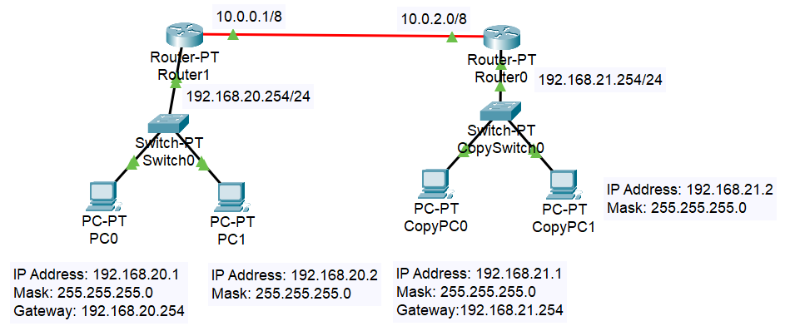
Routing Protocol
Why we need that

Slide 3
Routing Table
Destination Network | Next Hop
192.168.21.0/24 | 10.0.2.0

Slide 4
Routing Table
Destination Network | Next Hop
192.168.20.0/24 | 10.0.0.1
Destination Network | Next Hop
192.168.21.0/24 | 10.0.2.0

Slide 5
Routing
Static routing (previous slide)
Dynamic routing

Slide 6
RIP
Routing Information Protocol
Uses distance vector routing
Used hop count as metric
Routers exchange routing tables periodically
https://en.wikipedia.org/wiki/Routing_Information_Protocol
RIP & routing table basics using Packet Tracer
https://www.youtube.com/watch?v=8kaAfUOxZRI

Slide 7
Default Route for Router
Set a static ip
Network: 0.0.0.0
Subnet Mask: 0.0.0.0
Next Hop: <default ip>
Any packet that hits this router will be destined to <default ip>
https://www.youtube.com/watch?v=XyKxoDPr5_c

Slide 8
Some Commands
tracert (trace route)
Open PC command prompt
This gives you a list of nodes to reach destination
Example: tracert <ip> (just like ping <ip>).

Slide 9
FAQ
Why first ping fails sometimes?
Because remote router has to know MAC address of destination PC. So an ARP broadcast message is sent from remote router, while keeping the ping message on hold. So it times out on source PC. By the time the second ping comes, remote router knows the MAC address of destination PC.
https://www.pathsolutions.com/hubfs/PDF/PathSolutions-Why-Does-the-First-Ping-Usually-Fail.pdf

Slide 10
FAQ
What is Ping?
Ping is a computer network administration software utility used to test the reachability of a host on an Internet Protocol (IP) network.
Ping measures the round-trip time for messages sent from the originating host to a destination computer that are echoed back to the source.
Ping operates by sending Internet Control Message Protocol (ICMP) echo request packets to the target host and waiting for an ICMP echo reply. The program reports errors, packet loss, and a statistical summary of the results.
https://en.wikipedia.org/wiki/Ping_(networking_utility)

